Slide 1
Danish Nexus Web Application Documentation – 3/23/2018
Developer: Daniel Huang
danielhuang@ucla.edu

Slide 2
Table of Contents
Objective of Documentation
Repository Structure
Application Structure
Data Pipeline Overview
High Level
Detailed level
Notes

Slide 3
Objective of Documentation
This documentation serves as a reference in the case that:
New features want to be added
Previously unseen bugs need to be fixed
This documentation gives a high and low level documentation of the application written in React.js, a frontend web framework
This documentation will primarily focus on the Navigation component as this is the most complex and other components are still tentatively under development

Slide 4
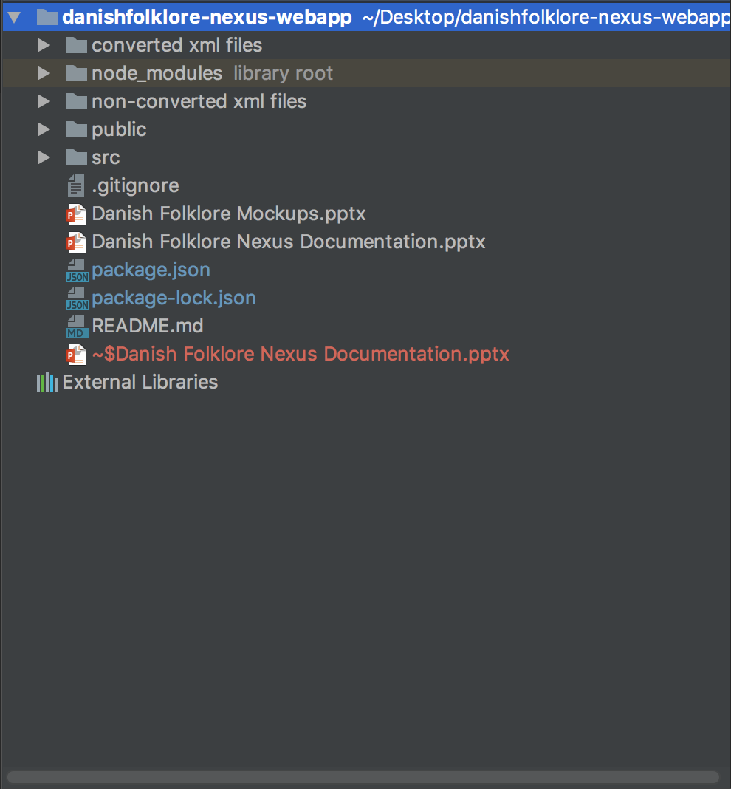
Repository Structure – Top Level 1
/Converted xml files + /non-converted xml files: temporary work files that contain xml to JSON conversion code + files
/Node_modules: directory that contains outside modules that are imported into the code via npm (a node package manager)
/Public: directory that contains files that are directly visible on the web application
/Src: “source” directory contains all of the important files that make up the application
Misc. Files: these files are important for telling how to run the application and how to access this documentation.

Slide 5
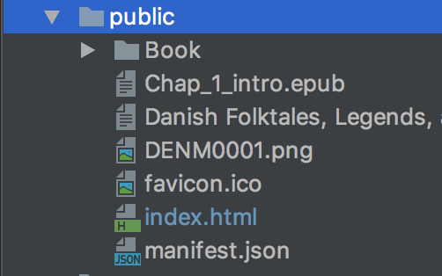
Repository Structure – Level 2: public
/Book: all of the individual chapter epub files
Various epub and images for the application (i.e. Danish flag)
Index.html: top level HTML file where all of the React.js javascript code is rendered to

Slide 6
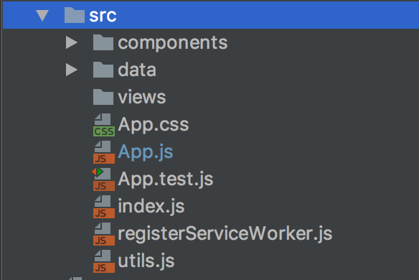
Repository Structure – Level 2: src
/Components: contains all of the individual building blocks of features that make up the website
/Data: contains all of the converted xml files including stories, stories_mentioned, fieldtrips, etc. as .json files
/Views: empty directory for the time being. Will be used to contain big view changes
App.css + App.js: code relevant to the entire application and initiates all other components to be created
Other files: these are helper files that are required by React.js to render the application into HTML, JS, and CSS

Slide 7
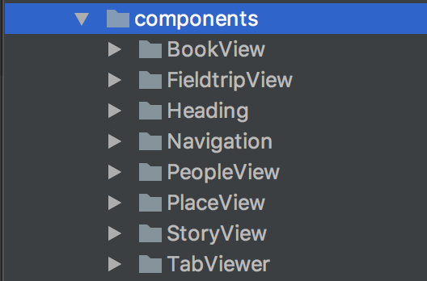
Repository Structure – Level 2: components
/BookView: component that loads the .epub files for the chapters in the book
/FieldtripView: component that displays associated data for Fieldtrips
/Heading: component that displays the heading of the website (black bar at the top)
/Navigation: component that allows for user to explore data by ontology or search term
/PeopleView: component that displays associated data for each person
/StoryView: component that displays associated data for each story
/TabViewer: component that displays any ___View component within its viewer as well as generates the tabs for each instance of a view

Slide 8
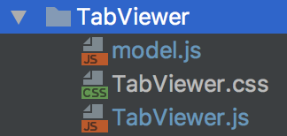
Repository Structure – Level 3: BookView, FieldtripView, Heading, PeopleView, StoryView, TabViewer
Model.js: Javascript code that formats the raw JSON object from /data (converted from XML) into a format appropriate for the component
[component].css: CSS code that styles all of the component
[component].js: Javascript code that contains all of the logic and HTML (JSX) necessary for the component to function

Slide 9
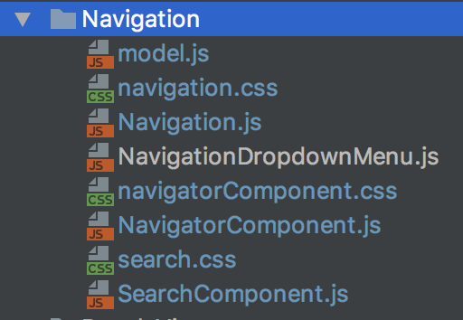
Repository Structure – Level 3: Navigation
Model.js: Javascript code that formats the raw JSON object from /data (converted from XML) into a format appropriate for the component
[component].css: CSS code that styles all of the component
[component].js: Javascript code that contains all of the logic and HTML (JSX) necessary for the component to function
Main Component: Navigation
Sets up the Navigator and Search into 1 larger component
Sub Component: Navigator
Contains the logic for navigating the data by ontology
Sub Component: Search
Contains the logic for search the data by keyword, annotations, and story text

Slide 10
Application Structure
App
Heading
TabViewer
Navigation
StoryView
PeopleView
FieldtripView
PlaceView
BookView
This diagram reflects the flow of data
Same color cells = siblings
i.e. data is passed between siblings
Darker colored cells = older generational components
i.e. data is passed to children component, data is received from parent component
Throughout the documentation, the flow of data will reflect this relationship

Slide 11
Data Pipeline: Overview
The Danish Nexus Web Application (DNWA) is a visualization of the Danish Folklore databased conceived, developed, and curated by Prof. Timothy Tangherlini, UCLA
The following slides describe step-by-step the process of how data is retrieved, manipulated, and displayed
Example:
“Process step”: Each unit in the above diagram
Each process step will have the associated function + file names
Example: renderStory(id); TabViewer.js
“Process flow”: a series of process steps that has a beginning and end event marked by a filled and empty circle
“Sub-Process Flow”: a series of process steps that make up a higher level process step
User selects story
TabViewer.js displays story data
Selected story data gets retrieved by model.js
Model.js passes story data to TabViewer.js

Slide 12
Data Pipeline: High Level
User selects an ontology
Is ontology from a Data Navigation or Topics & Indices?
TabViewer.js adds new data display view as a new tab
Yes
No
Element – story, person, place, fieldtrip
Navigation options – dropdown menu, list of options, etc.
Search query of result selection – example: user selects Story A, Navigator.js gives instructions on how to get the data for Story A.
User selects a result
TabViewer.js creates appropriate data display view
Navigator retrieves search query of result selection and passes it to TabViewer.js
TabViewer.js receives search query of result selection, and performs search query to receive result data
Notes:
Interpretation: This provides the process, on a high level, of how data is flowing throughout the application

Slide 13
Data Pipeline: Navigator Component
User selects an ontology
Function
handleLevelTwoClick();
NavigatorComponent.js: line 85
Is ontology a Data Navigator Item or Topics & Indices Ontology?
Send item to navigation to display results
Data Navigator Selection
Topics & Indices Selection
Is ontology a fieldtrip?
Yes
No
Is ontology a Tangherlini Index?
Display list of Tangherlini Index keys in a dropdown menu
Display dropdown list of ontologies
Notes:
Interpretation: This provides the process for when a user clicks on an ontology on the navigation component on home tab (located on the bottom left with 2 tabs). When a user selects an ontology, the associated results should be displayed. If it’s People, Places, Stories, or Fieldtrip then all the associated items will be displayed in the navigation results viewer. If it’s from the Topics and Indices tab, then display a dropdown list of sub ontologies.

Slide 14
Data Pipeline: Navigator Component
User selects an ontology from the dropdown menu previously generated
Function
selectMenu();
NavigatorComponent.js: line 142
Is ontology a Tangherlini Index?
Display dropdown list of ontologies
Yes
No
Send item to navigation to display results
Notes:
Interpretation: This provides the process for when a user clicks on an ontology from the dropdown menu on the navigation component on home tab (located on the bottom left with 2 tabs). This is a continuation of the last process step from handleLevelTwoClick();

Slide 15
Data Pipeline: Search Component
User activates search input box
Function
handleFuzzySearch();
SearchComponent.js: line 61
getKeywords();
/Navigation/model.js: line 76
Create list of possible keywords including keyword xml and stories xml [getKeywords();]
Is search input empty?
Display dropdown list of all possible keywords
Yes
No
Display dropdown list of keywords that match search input ranked by keyword weight
Notes:
Interpretation: This provides the process for when a user searches a term in the search input box. The search primarily works through fuzzy search where keywords that match what the user is typing will appear in a dropdown menu, and users can click on a keyword.

Slide 16
Data Pipeline: Search Component
User selects search term
Function
handleSearch();
SearchComponent.js: line 41
Is search term a story or keyword?
Send list of associated stories with keyword to Navigation
Story
Keyword
Format keyword data to be sent to Navigation
Notes:
Interpretation: This provides the process for when a user selects a search term from the suggested search term dropdown. Sends the list of associated stories of keyword/story selection to Navigation component.

Slide 17
Data Pipeline: Navigation Component
Receive Items to display from Navigator or Search Components
Functions
updateItems();
Navigation.js: line 145
dateFilterHelper();
/Navigation/mod0el.js: line 199
Save the current state in localStorage so user can navigate between tabs without losing search/navigation settings
Update list of items to display
Update displayItemsList with what is in the timeline filter
Display items in displayItemsList
Is time filter on?
Yes
No
Notes:
Interpretation: This is the process that is executed when the list of items to display in the associated results viewer is received from the Navigator or Search Components. This also checks if the results need to be filtered by time.

Slide 18
Data Pipeline: Navigation Component
Timeline is turned on
Function
timeFilterHandler();
Navigation.js: line 184
Set new time filter settings (fromDate and toDate)
Update displayItemsList with what is in the timeline filter
Notes:
Interpretation: This is the process that is executed when timeline is turned on. It updates variables within Navigation component to update the list of displayed items.

Slide 19
Data Pipeline: Navigation Component
Update Items is called
Functions
updateItems();
Navigation.js: line 145
dateFilterHelper();
/Navigation/mod0el.js: line 199
Exit out of update items, continue displaying items
Is time filter on?
No
Yes
Get items that are within the fieldtrip [dateFilterHelper();]
Display relevant display items (people, place, story)
Display list of fieldtrips that fit the time filter
Are items fieldtrips?
No
Yes
Notes:
Interpretation: This is the process that is executed when timeline is turned on. It updates the list of displayed items with as set by the time filter.

Slide 20
Notes
The navigation component was coded from “scratch” to optimize speed and to be flexible in the case that future updates of the application require it.
Some future considerations include
Possibility of adding Elastic Search Stack
New Mapping component + layers
Search by ontology filter

